Slide 1
CSCI 4370 Project 5
By: Jey, Justin, Narita, Phillip, and Ryan

Slide 2
Project Overview
Database holding information for a company’s rewards program
Real world application
Widely used system
Our version
For buying shoes
Users put into tiers based on number of points
Higher tiers have more discounts given
Points reset every quarter, when the “coupons” are sent out
Java Server Pages (JSP)
Allows communication between database and website via servlets

Slide 3
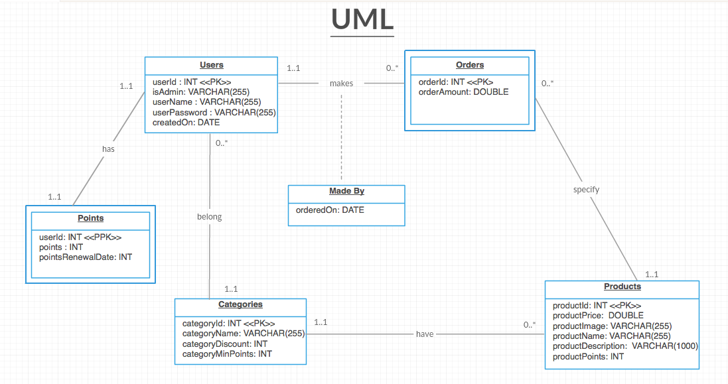
UML Diagram

Slide 4
Convert UML to Relational Model (ρ₁)
Users(userID, isAdmin, userName, userPassword, createdOn)
Points(userID, points, userCategoryID, pointsRenewalDate)
Categories(categoryID, categoryName, categoryDiscount, categoryMinPoints)
Products(productID, productPrice, productImage, ProductName, productDescription, productPoints, productCategoryID)
Orders(orderID, userID, productID, orderAmount)

Slide 5
Functional Dependencies
UserId → isAdmin, userName, userPassword, userCreatedOn, points, pointsRenewal
productId → productPrice, productName, productDescription, productCategoryId, productPoints, productImage
categoryId → categoryName, categoryMinPoints, categoryDiscount
orderId → orderedOn, amount, orderProductId, userId
userName → isAdmin, userPassword, userCreatedOn

Slide 6
1NF
DBMS Project 5
userId <<PK>> isAdmin userName userPassword userCreatedOn points pointsRenewal categoryId categoryName categoryMinPoints categoryDiscount productId productPrice productName productDescription productCategoryId productPoints productImage orderId orderedOn amount

Slide 7
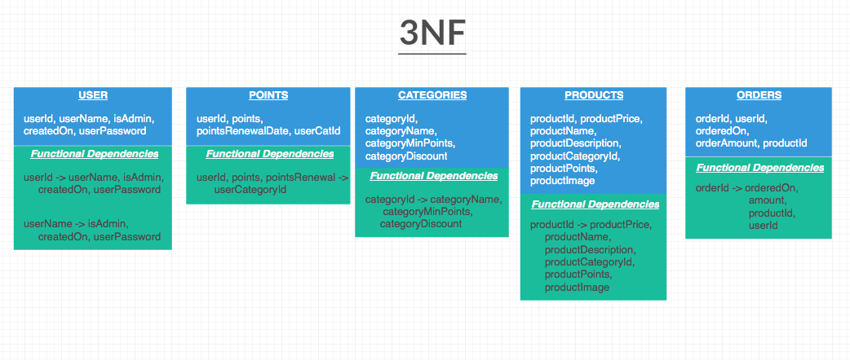
3NF Synthesis Algorithm (ρ₃ )

Slide 8
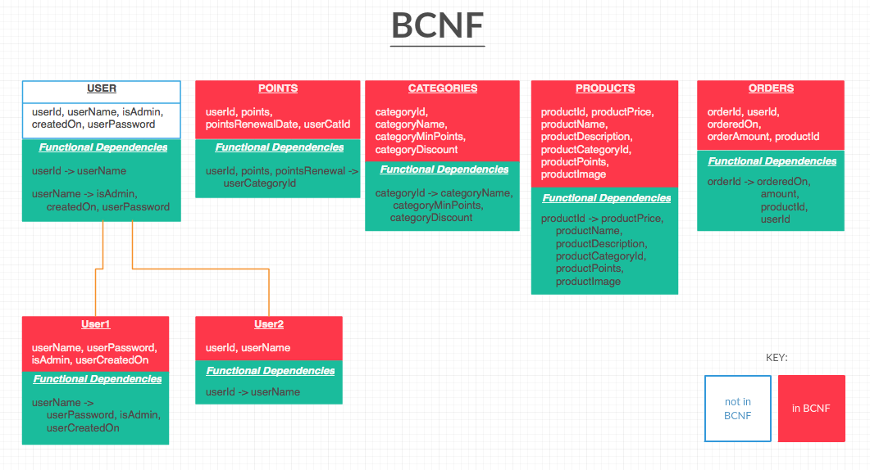
BCNF Decomposition Algorithm (ρ₂)

Slide 9
Comparison of ρ₁, ρ₂, and ρ₃
- ρ₁ = 5
- ρ₂ = 6
- ρ₃ = 5
- ρ₁ = ρ₃

Slide 10
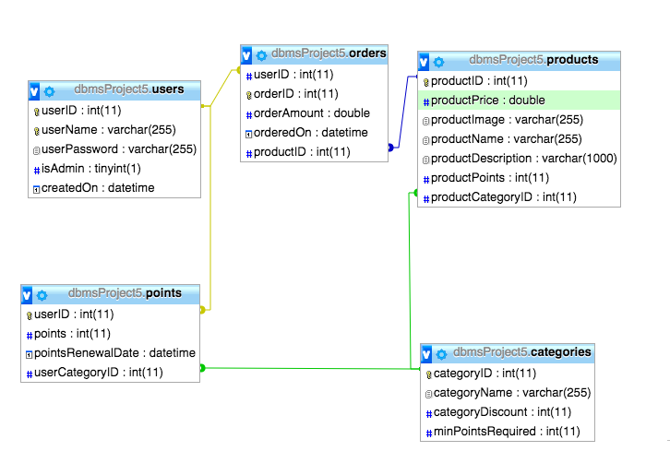
Schema

Slide 11
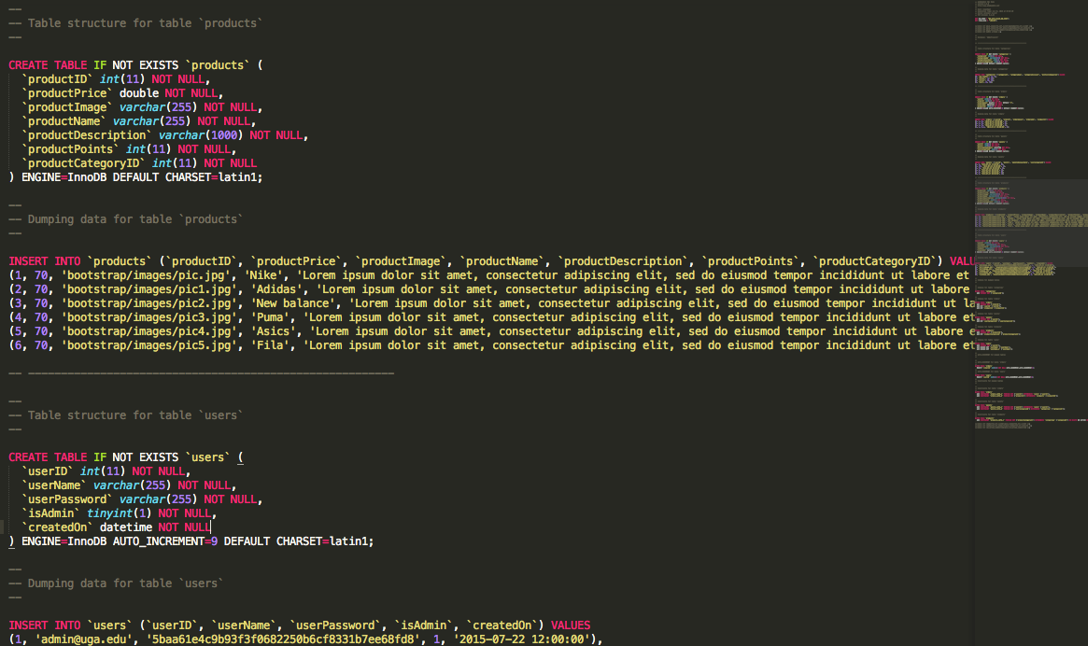
Inserts

Slide 12
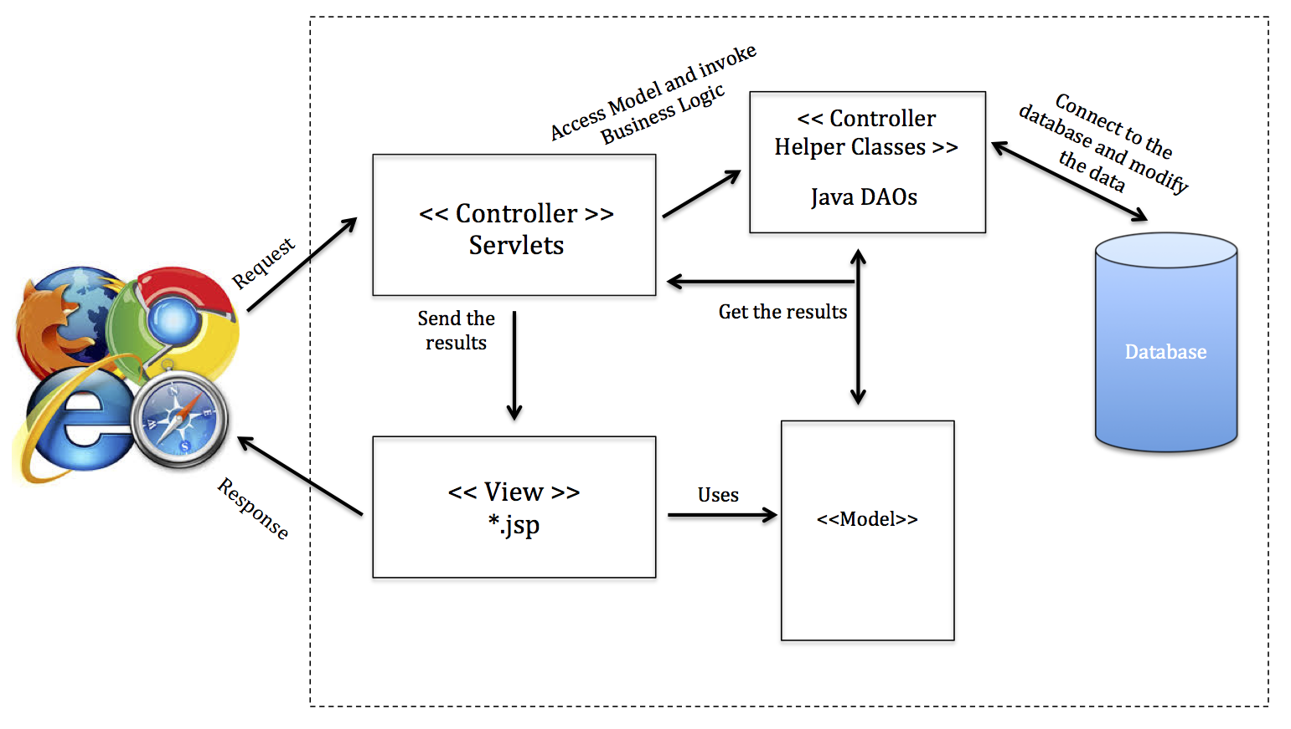
Architecture and Components

Slide 13
Demo time

Slide 14
Questions?

